Slide 1
VOCATIONAL TRAINING
AND
VARIOUS SCHEMES FOR GIRLS

Slide 2
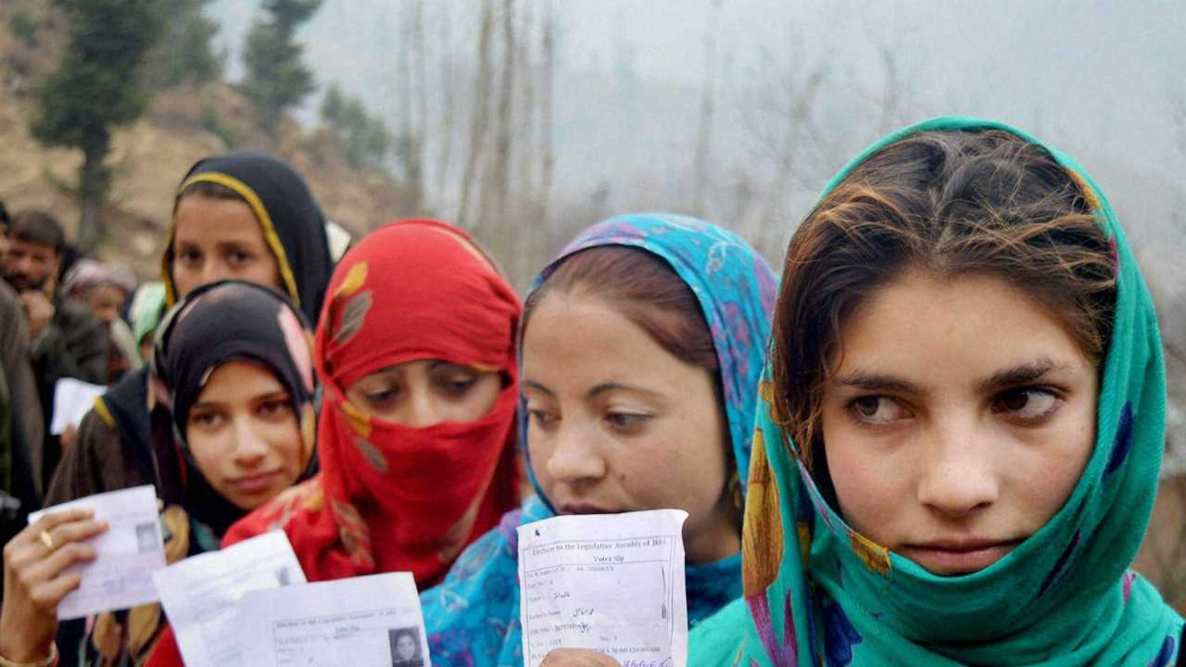
J&K GOVT SCHEME
SCHEME - PENSION FOR OLD AGE WOMEN.
BENEFICIARY – INDIAN WOMEN 55 YEARS AND ABOVE.
ELIGIBILITY
  NO SOURCE OF OWN INCOME OR SUPPORT FROM FAMILY MEMBERS.
  SON/ SONS BELOW 20 YEARS OF AGE.
PENSION SCHEME - RS 200 PER MONTH PER BENEFICIARY.
HOW TO APPLY?
  APPLICATION THROUGH GRAM PANCHAYAT TO BLOCK DEVELOPMENT OFFICER FOR SANCTION.
  CAN APPLY THROUGH OFFICIAL WEBSITE Jksocialwelfare.nic.in

Slide 3
J&K GOVT SCHEME
MAIN FEATURES
  ONLY FOR PREGNANT AND LACTATING MOTHERS WHO LOST THEIR JOB.
  CASH INCENTIVES IN THREE INSTALLMENTS ON CHILD BIRTH, AFTER 150 DAYS AND AFTER 180 DAYS.
  IST INSTALLMENT – RS 1000/- (ON CONCEIVING)
  2ND INSTALLMENT - RS 2000/-
  ( CLAIM TO BE RAISED 180 DAYS AFTER LMP)
  3RD INSTALLMENT – RS 2000/-
  ( A LACTATING MOTHER MAKE CLAIM AFTER CHILD BIRTH)
SCHEME-
PRADHAN MANTRI MATRU VANDANA YOJNA
BENEFICIARIES-
PREGNANT WOMEN AND LACTATING MOTHERS

Slide 4
J&K GOVT SCHEME
SCHEME-
LADLI BETI
BENEFICIARIES-
GIRL CHILD FROM ECONOMICALLY DISADVANTAGED SECTION.
ELIGIBILITY
PARENTS TO BE PERMANENT RESIDENTS OF J& K (UT).
MUST BE BORN AFTER 01 APR 2015.
PARENTS ANNUAL INCOME FROM ALL SOURCES IS LESS THAN RS 75,000/-
MAIN FEATURES
  IMPLEMENTATION IN TWO PHASES.
  PHASE I - RECURRING DEPOSIT FOR 14 YRS @ 1000 PER MONTH BY J & K (UT) ADMINISTRATION.
  PHASE II- A CUMULATIVE TERM DEPOSIT FOR 07 YRS.
MATURITY BENEFITS ON COMPLETION OF 21 YRS OF AGE. TO GIRL CHILD ONLY.
LIFE CERTIFICATE CERTIFIED BY A GAZETTED OFFICER/ PRINCIPAL OF SCHOOL/COLLEGE WHERE GIRL CHILD IS ENROLLED .
NOMINATION FACILITY NOT APPLICABLE.

Slide 5
J&K GOVT SCHEME
SCHEME-
STEP (SUPPORT TO TRAINING AND EMPLOYMENT PROGRAMME FOR WOMEN)
BENEFICIARIES-
MARGINALISED, ASSET LESS RURAL WOMEN AND URBAN POOR.
ELIGIBILITY-
WOMEN OF 16 YRS AGE OR ABOVE.
INSTITUTIONS AND ORGANIZATIONS REGISTERED UNDER THE SOCIETY REGISTRATION ACT.
CO-OPERATIVE SOCIETIES REGISTERED UNDER CO-OPERATIVE SOCIETY ACT.
MAIN FEATURES
  VOCATIONAL SKILL TRAINING BY A REGISTERED NGO.
  PLACEMENT WITH REGISTERED FIRMS.

Slide 6
SCHEME-
TEJASWANI YOUTH SCHEME.
BENEFICIARIES-
WOMEN/GIRLS OF J& K (UT) ASPIRING TO START OWN BUISNESS.
ELIGIBILITY
PERMANENT RESIDENT OF J & K (UT).
WOMEN/GIRLS FROM AGE 18 TO 35 YRS.
SHOULD NOT BE IN ANY GOVT JOB.
SHOULD HAVE A UNIQUE IDEA OF STARTUP/BUISNESS.
J&K GOVT SCHEME
MAIN FEATURES
  LOAN OF RS 5 LACS
  10% COST OF PROJECT TO BE BORNE BY MISSION YOUTH AND PAID IN FIVE YRS.

Slide 7
SCHEME-
JK SUPER 75 SCHOLARSHIP
BENEFICIARIES-
GIRL STUDENTS FROM ECONOMICALLY DISADVANTAGED SECTION
ELIGIBILITY
MUST BE NATIVE OF J & K (UT).
SHOULD HAVE OBTAINED GOOD MARKS
IN 10 & 12th STD.
J&K GOVT SCHEME
MAIN FEATURES
  PRIMARILY FOR GIRLS FROM ECINOMICALLY DISADVANTAGED SECTION OF SOCIETY.
  PARTICULARLY FOR PURSUING HIGHER STUDIES IN MEDICAL, ENGINEERING OR COMPUTER FIELD.
  SHOULD BE STUDYING IN RECOGNIZED GOVT SCHOOL IN J& K (UT).
  10% SCHOLARSHIP RESERVED FOR GIRLS WHO OST THEIR FATHER TO INSURGENCY.
  04% SEATS RESERVED FOR STUDENTS FROM PWD CATEGORY.
  40% RESERVED FOR PHYSICAL DISABILITY.

Slide 8
SCHEME
COMBINED COUNSELLING BOARD SCHOLARSHIP, J & K.
BENEFICIARIES - DOMICILED/ PERMT RESIDENT FROM J&K (UT).
ELIGIBILITY
STUDENTS STUDYING AT THE COLLEGE / UNIVERSITY LEVEL.
PURSUING DIPLOMA, DEGREE OR PG LEVEL COURSES.
SHOULD HAVE SECURED MINIMUM 40% TO 50 % MARKS IN LAST QUALIFYING EXAM.
J&K GOVT SCHOLARSHIP SCHEME
HOW TO APPLY?
  APPLY ONLINE THROUGH THE OFFICIAL WEB PAGE OF COMBINED COUNSELLING BOARD
  http://ccbnic.in
MAIN FEATURES
SCHOLARSHIP OF RS I LAC TO 03 LAC PER ANNUM.

Slide 9
SCHEME-
PRIME MINISTER SPECIAL SCHOLARSHIP SCHEME , J & K.
BENEFICIARIES-
DOMICILED/ PERMT RESIDENT FROM J&K (UT).
ELIGIBILITY
SHOULD HAVE PASSED CLASS 12TH FROM
J & K BOARD OR CBSE AFFILIATED SCHOOLS IN J & K.
MUST BE PURSUING A GENERAL, PROFESSIONAL
OR MEDICAL DEGREE COURSE.
MUST BE WILLING TO TAKE ADMISSION
OUTSIDE J& K.
ANNUAL INCOME OF FAMILY MUST BE
LESS THAN INR 8 LAKH.
STUDENTS WHO HAVE COMPLETED 10+3
FROM UT POLYTECHNICS CAN ALSO APPLY.
J&K GOVT SCHOLARSHIP SCHEME
MAIN FEATURES
  FOR GENERAL DEGREE COURSE
    ACADEMIC FEE UPTO RS 30,000/-
    AND MAINTAINANCE FEE UPTO RS 01 LAC.
  FOR PROFESSIONAL DEGREE COURSE
    ACADEMIC FEE UPTO RS 1.25 LAC
    AND MAINTAINCE CHARGES UPTO RS 01 LAC.
  FOR MEDICAL/BDS OR EQUIVALENT MEDICAL STREAMS
    ACADEMIC FEE UPTO RS 3 LAC AND
    MAINTAINANCE FEE UPTO RS 01 LAC.

Slide 10
SCHEME
KASHMIR EDUCATION INITIATIVE SCHOLARSHIP 2022.
BENEFICIARIES - DOMICILED/ PERMT RESIDENT FROM J&K (UT).
ELIGIBILITY
75% MARKS IN CLASS 8 EXAMINATION HELD IN NOV OR DEC OF YR 2021.
TOTAL FAMILY INCOME SHOULD NOT EXCEED RS 3 LAC.
J&K GOVT SCHOLARSHIP SCHEME
MAIN FEATURES
SCHOLARSHIP OF RS 20,000/- PER ANNUM.
HOW TO APPLY?
  APPLY ONLINE THROUGH THE OFFICIAL WEB PAGE OF COMBINED COUNSELLING BOARD
  http://ccbnic.in

Slide 11
SCHEME-
KASHMIR EDUCATI ON SCHEME CBSE SCHOLARSHIP
BENEFICIARIES
ONE GIRL CHILD PER FAMILY ACROSS INDIA.
ELIGIBILITY
MUST BE INDIAN CITIZEN.
MUST BE STUDYING IN GOVT SCHOOL AFFILIATED TO CBSE BOARD.
ONLY ONE GIRL CHILD APPLICATBLE FROM A FAMILY.
SCHOOL FEE NOT TO BE MORE THAN RS 1500 PER MONTH.
MUST HAVE SECURED 60% OR 6.2 CGPA IN HER 10TH BOARD EXAM.
J&K GOVT SCHOLARSHIP SCHEME
MAIN FEATURES
  TO SUPPLIMENT SCHOOL TUTION FEE.
  RELAXATION OF RS 500/- IN SCHOOL TUTION FEE.
HOW TO APPLY?
  APPLY THROUGH SCHOOLS ONLY.

Slide 12
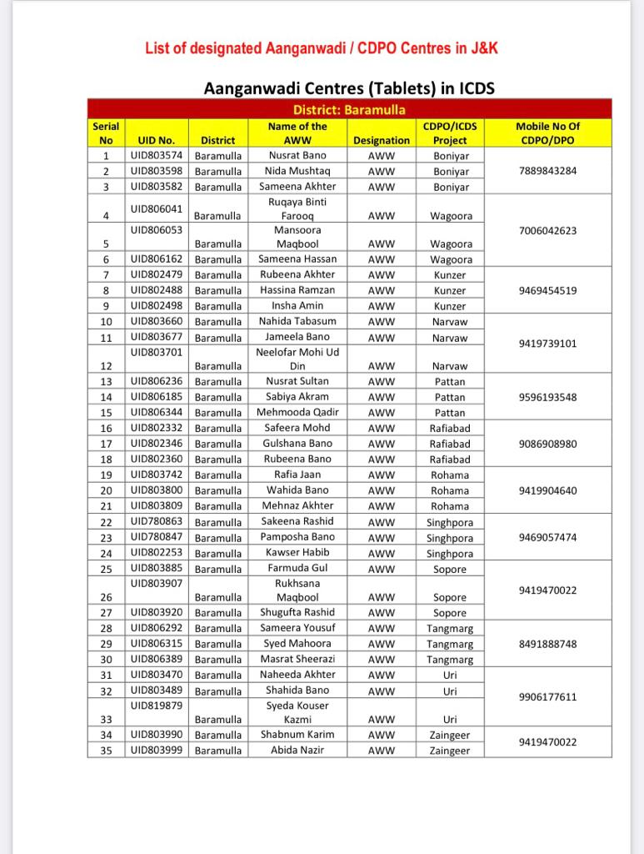
CHILD DEVELOPMENT PROJECT OFFICER
Notes:
12

Slide 13
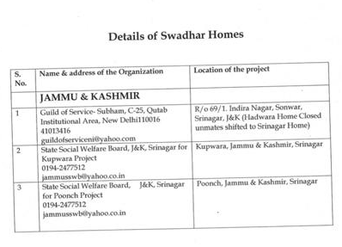

Slide 14
CENTRAL GOVT SCHEME
SCHEME -
BETI BACHAO BETI PADHAO
BENEFICIARIES-
YOUNG AND MARRIED COUPLES AND PREGNANT MOTHERS.
MAIN FEATURES
  EASY SAVING FACILITY FOR DAUGHTERS.
  MINIMUM RS 1000/- AND MAXIMUM RS 1.5 LAKH DEPOSIT ALLOWED IN A YEAR.
  ACCOUNT EXEMPTED FROM TAX.
  INTEREST RATE 7.6% PER ANNUM.
  WITHDRAWALS ONLY ONCE GIRL TURNS 18 YEARS.

Slide 15
CENTRAL GOVT SCHEME
SCHEME-
MAHILA E - HAAT
BENEFICIARIES-
WOMEN ENTREPRENEURS, WOMEN SELF-HELP GROUPS (SHG), NGOs.
ELIGIBILITY-
WOMEN ENTREPRENEURS MUST BE INDIAN CITIZEN.
PRODUCTS SOLD MUST BE LEGAL.
MAIN FEATURES
  VOCATIONAL SKILL TRAINING BY A REGISTERED NGO.
  PLACEMENT WITH REGISTERED FIRMS.
  SHOWCASING OF PRODUCT THROUGH ONLINE PLATFORM.
  PRODUCTS INCLUDE CLOTHING, POTTERY, BOXES, FASHION ACESSORIES.
  BUYERS CAN REACH SELLERS TELEPHONICALLY, PHYSICALLY OR BY E-MAIL.

Slide 16
SCHEME-
MAHILA POLICE VOLUNTEERS
BENEFICIARIES-
INDIAN WOMEN
ELIGIBILITY
WOMEN APPLICANT MUST BE 21 YRS AGE.
WOMEN APPLICANT MUST HAVE A 12TH GRADE CERTIFICATE.
SHOULD BE FROM SAME GEOGRAPHICAL AREA AND MUST KNOW THE LOCAL LANGUAGE.
SHOULD NOT HAVE CRIMINAL RECORD.
SHOULD NOT BE MEMBER OF ANY POLITICAL PARTY.
CENTRAL GOVT SCHEME
MAIN FEATURES
  INTIAL TERM PERIOD OF EMPLOYMENT – 02 YEARS.
  03 DAYS TRAINING TRAVELLING AND DA @ RS 400/-.
  RS 1000/- PER MONTH FOR TRAVEL AND MOBILE EXPENSE.

Slide 17
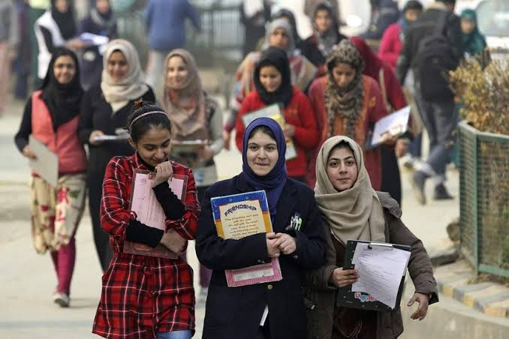
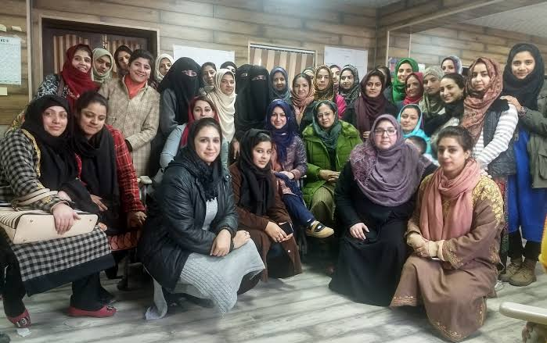
SCHEME-
WORKING WOMEN HOSTEL.
BENEFICIARIES-
WORKING WOMEN (SINGLE, WIDOWED, MARRIED , DIVORCED, SEPERATED) , RESERVATIONS FOR WOMEN SPECIALLY ABLED WOMEN.
ELIGIBILITY-
WORKING WOMEN WHOSE HUSBAND OR FAMILY DOES NOT RESIDE IN SAME CITY/AREA.
WOMEN UNDERGOING TRAINING (NOT EXCEEDING ONE YEAR)
MONTHLY INCOME (NOT EXCEEDING Rs 50,000/- IN METROPLITON CITY, RS 35,000/- IN OTHER CITIES)
CENTRAL GOVT SCHEME

Slide 18
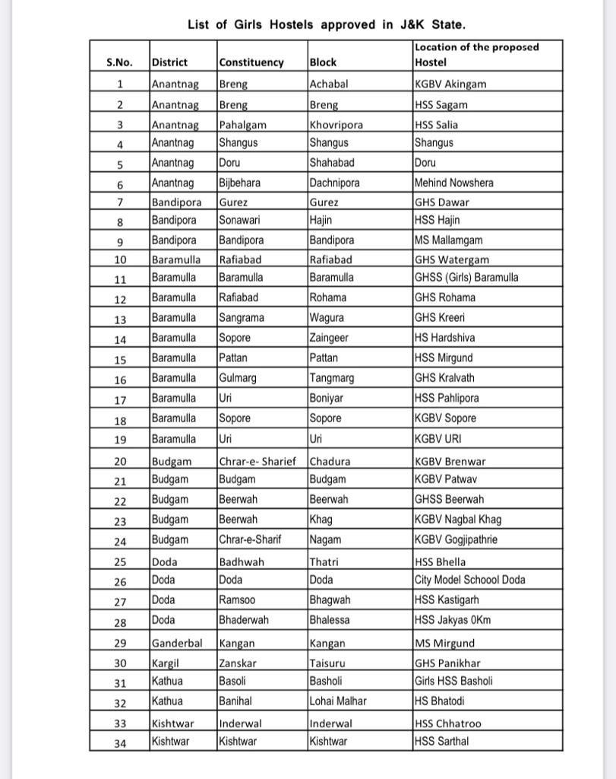
APPROVED WOMEN HOSTEL IN J& K
Notes:
18

Slide 19
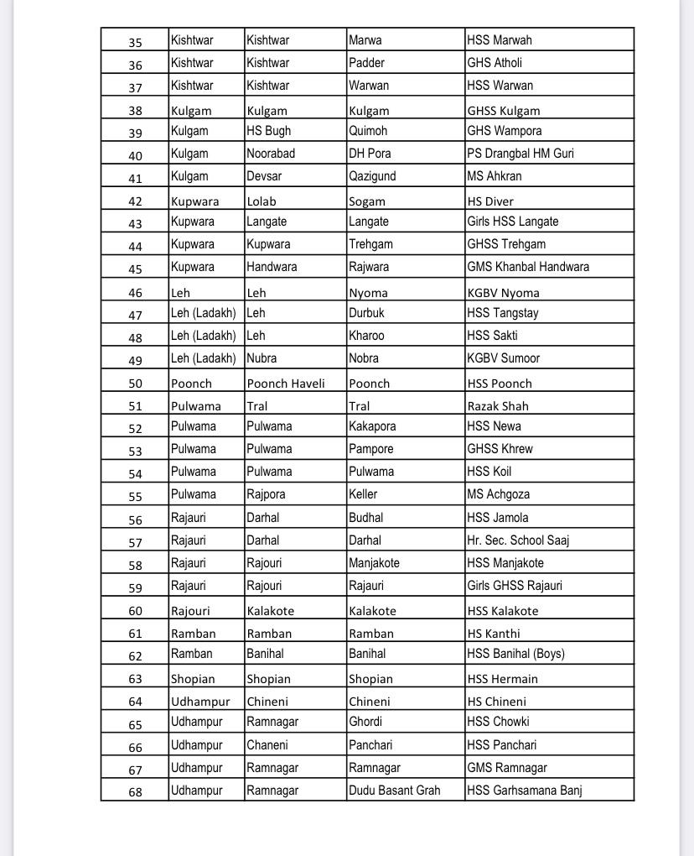
APPROVED WOMEN HOSTEL IN J& K
Notes:
19

Slide 20
SCHEME-
TERM LOAN SCHEME
BENEFICIARIES-
WOMEN OF J & K (UT)
FUNDING BY-
WOMEN’S DEVELOPMENT CORPORATION.
ELIGIBILITY-
SKILLED FOR ANY LOCAL CRAFT WHICH IS VIABLE.
18 TO 45 YRS AGE GROUP.
PERMANENT RESIDENT OF J & K (UT).
ANNUAL FAMILY INCOME - RS 1,20,000/-( FOR URBAN AREA),
RS 98,000 (FOR RURAL AREA).
CENTRAL GOVT SCHEME
STEP I- REGISTRATION ON OFFICIAL WEBSITE https://www.jkwdc.com
STEP 2 - TWO ROUNDS SCREENING BASED ON APPLICATION.

Slide 21
SCHEME - VIRASAT TERM LOAN SCHEME
BENEFICIARIES-
WOMEN OF J & K (UT)
PURPOSE-
FOR PURCHASE OF EQUIPMENT/TOOLS/MACHINERY.
FUNDING BY-
WOMEN’S DEVELOPMENT CORPORATION.
ELIGIBILITY-
SHOULD HAVE ARTISAN CARD.
18 TO 45 YRS AGE GROUP.
PERMANENT RESIDENT OF J & K (UT).
ANNUAL FAMILY INCOME - RS 1,20,000/-( FOR URBAN AREA),
RS 98,000 (FOR RURAL AREA).
CENTRAL GOVT SCHEME
STEP I- REGISTRATION ON OFFICIAL WEBSITE https://www.jkwdc.com
STEP 2 - TWO ROUNDS SCREENING BASED ON APPLICATION.

Slide 22
SCHEME-
HAUSLA
BENEFICIARIES-
WOMEN OF J & K (UT)
FUNDING BY-
WOMEN’S DEVELOPMENT CORPORATION.
ELIGIBILITY-
WOMEN RESIDENT OF J & K (UT).
ABOVE 18 YRS OF AGE.
OWNING MORE THAN 33% OF THE ENTERPRISES.
HAS COMMENCED BUISNESS OPERATION.
CENTRAL GOVT SCHEME
STEP I- REGISTRATION ON OFFICIAL WEBSITE https://hausla.jktpo.in
STEP 2 - TWO ROUNDS SCREENING BASED ON APPLICATION.
STEP 3 - SIX WEEKS TRAINING FOR SELECTED WOMEN/GIRLS.

Slide 23
SCHEME-
ONE STOP CENTRE .
AIMED AT-
WOMEN AFFECTED BY VIOLENCE.
BENEFICIARIES-
ALL WOMEN, INCLUDING GIRLS AGED BELOW 18.
HOW TO APPLY-
NO APPLICATION PROCESS.
CENTRAL GOVT SCHEME
HOW TO ASK FOR HELP?
  BY COMMUNICATING OWN SELF.
  THROUGH WOMEN HELPLINE (181)
  OTHER EMERGENCY RESPONSE HELPLINE.
  THROUGH ANY PERSON SUCH AS PUBLIC SERVANT, FRIEND , NGO, RELATIVE AND VOLUNTEERS.

Slide 24
JAI HIND

